Slide 1


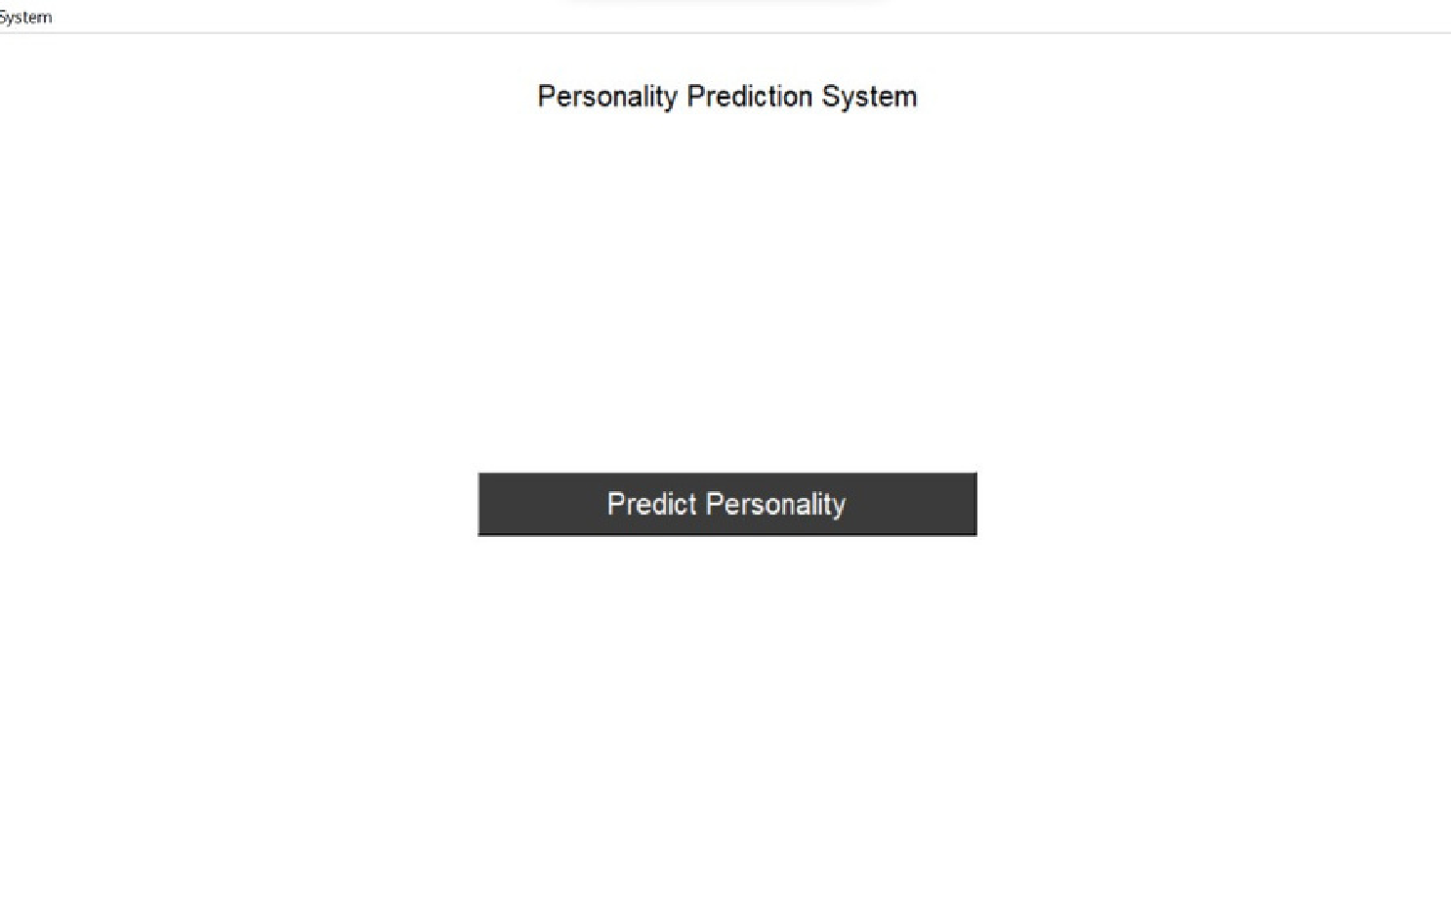
CV Analysis Tool
Artificial Intelligence - 18CSC305J
Section Q1
RA1911032010026 SANKET SINGH RA1911032010027 SUYASH NIGAM RA1911032010028 OM RAJPUT
Faculty Incharge - Dr. Vaishnavi Moorthy

Slide 2

TECHNIQUES
PROBLEM STATEMENT
This personality prediction system can be used in many business parts or areas that may require expert candidates.
Admin can easily shortlist a candidate based on their personality scores. This system will reduce the workload of the workers in general/hiring, training, and firing department.
This system will help to select the right candidate for the desired job profile, which in turn provide the expert for the organization.
BENEFIT TO SOCIETY
Usually companies hire employees based only on their achievements in their field along with their outstanding grades and resume.
But in the recent years, this has proven not to be enough. In order to hire the right employee for a company, the company should know about the persons behaviour and attitude.
This project aims to help out the hiring community not only in the tech industry but in every field.
FRONTEND - Tkinter LOGISTIC REGRESSION
NATURAL LANGUAGE PROCESSING
PROCESS DIAGRAM
USER
Atitude Prediction
Resume NLP
Analysis
UI/UX
ML Model
Data
processing screen
Resume get Personality
Predict
Personality
Output Personality

Slide 3

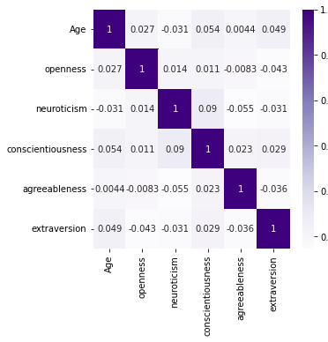
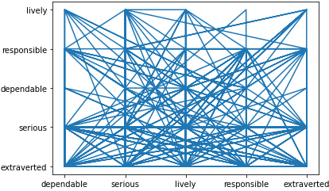
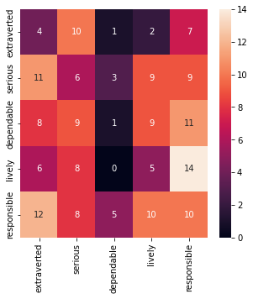
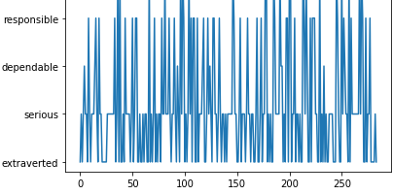
GRAPHS
INFERENCE
In order to help computers understand resumes, the computed must to taught the format in which the resume exist.
But more often than not, all resumes follow different formats. So for them, NLP must be used.
Given a dataset, the data can be analyzed using machine learning, for future predictions. The analysis technique chosen is Logistic Regression.
FUTURE ENHANCEMENTS
Resume Elimination based on company requirement. AI based interviews based on resumes.
This project aims to help out the hiring community not only in the tech industry but in every field.
Data Set Information and Github Link
Open Source Dataset https://tinyurl.com/2p8hsj3p
GitHub Link - https://github.com/or6857/CV-Analyser

Slide 4
THANK YOU

